Slide 1
YOUTH CAFE Report for Community Council
24th October – 20th November 2022

Slide 2
WANDA!
On Halloween, 4 of our Young Leaders / Volunteers, created mask and Capes .
Why have one Wanda when we can have 5! OHHH wouldn’t that be a dream!

Slide 3
Numbers
Number of Contacts: - 246
Learning hour: - 379

Slide 4
Choose to Lead Level 4
10 young people are taking part in the Highlife Highland Choose to Lead Level 4 Award (SCQF Rated Level 4)
The choose to lead award focus’s on Young people planning, preparing, delivering & then evaluating the session.
These sessions will be delivered at Multi-Sports, After school clubs, Rowing & Youth Café.
Young people need to deliver 40 hours of there time to gain the award while filling in there paperwork.
This is overseen by Wanda and will then be signed of by University of Inverness (UHI)

Slide 5
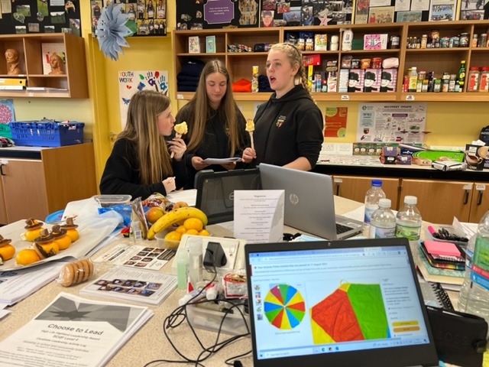
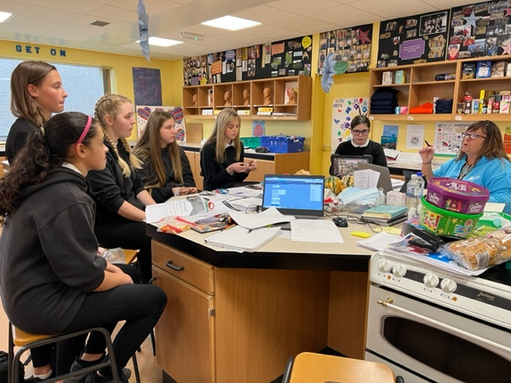

Slide 6
Saltire Awards & HLH Leadership
A number of young people from Cromarty are signed up for Saltire Awards & HLH Leadership:
Young people volunteer and lead at many different sessions weekly, such as, Multi-Sports, Jnr Youth Café, Football, Leading sessions on a Friday afternoon at Cromarty Primary School, Support with Fortrose Academy Breakfast club.
These young people are youth ambassadors.

Slide 7
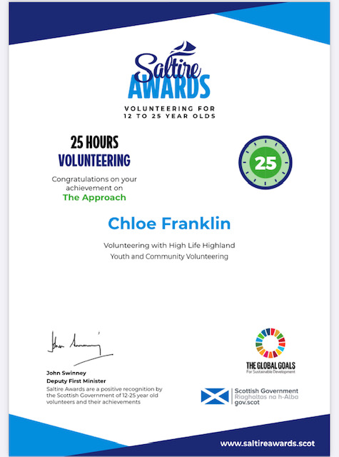
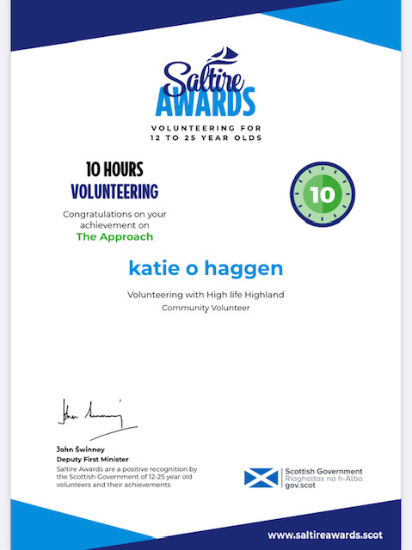

Slide 8
Wider Achievement
Over the last month young people have been taking part in a range of different wider achievement courses:
Food Hygiene Level 1 & Level 2
Child Protection
Smart Start
Child Healthy Weight

Slide 9
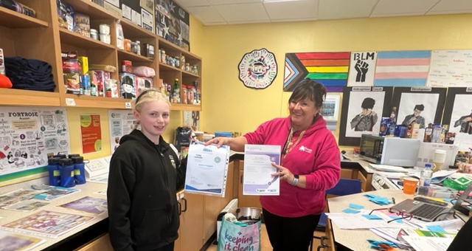
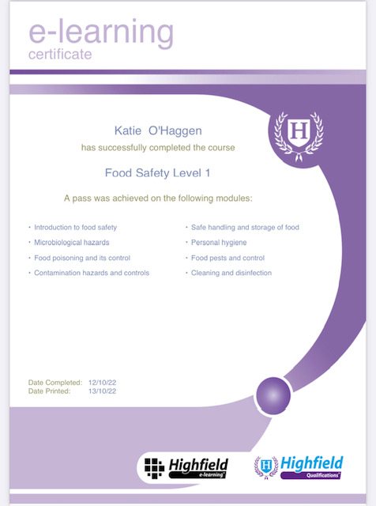
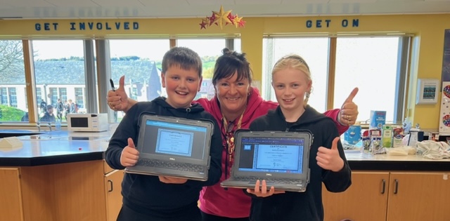

Slide 10
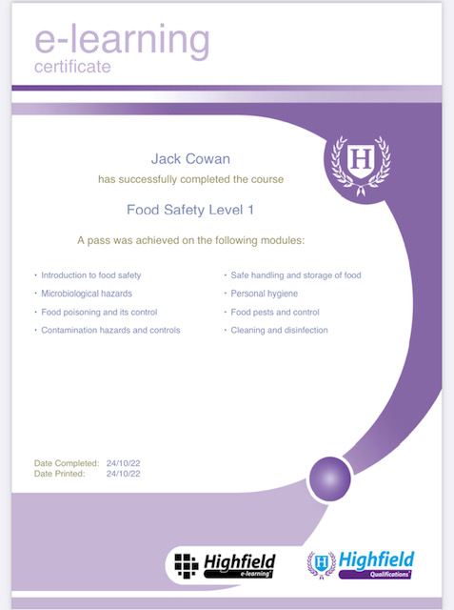

Slide 11
Football Coaching
Weekly session with Inverness Caley Thistle Football Academy.
Over 30 young people attending each session
At each session young people are learning new skill, and drill for football.

Slide 12
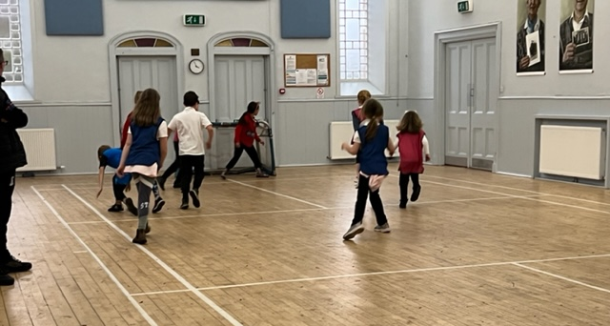
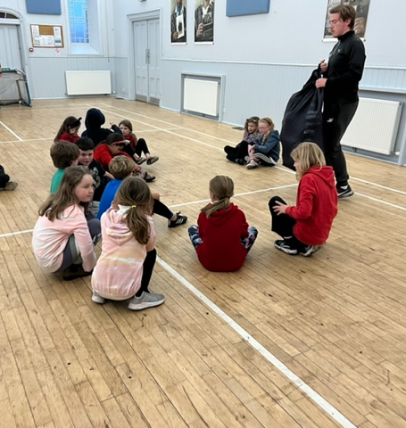
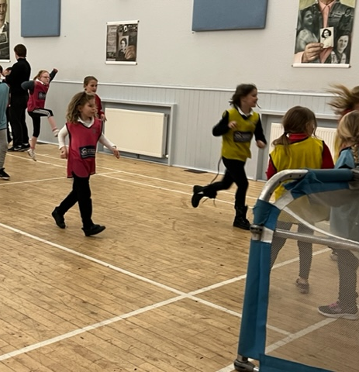
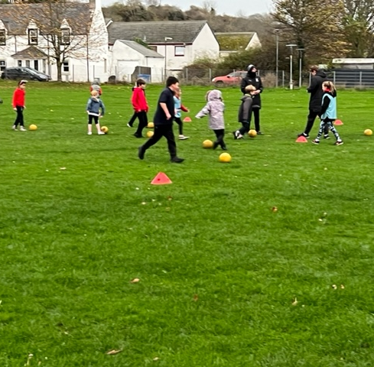

Slide 13
Jnr Youth Café
Weekly sessions with around 50 attendees weekly,
Each session is planned and delivered by Young people and supported by Wanda & myself,
Youth Consultation about what young people would like too see at the Youth Café & Creating their own code of conduct.
Christmas Arts & crafts

Slide 14
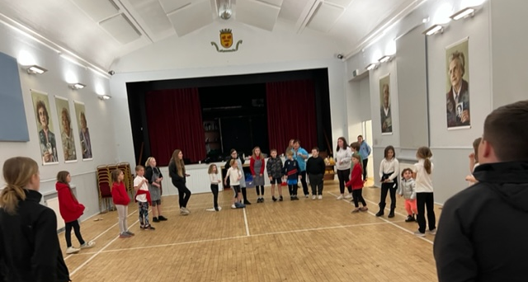
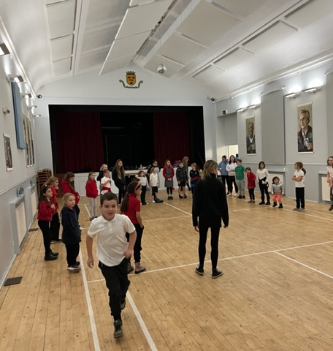
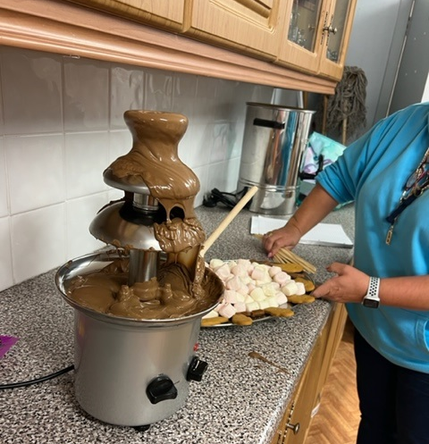
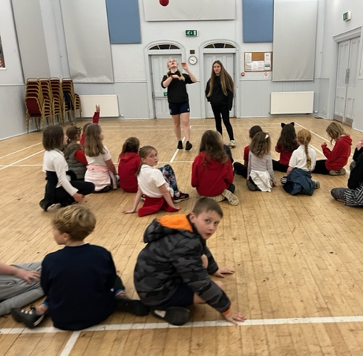

Slide 15
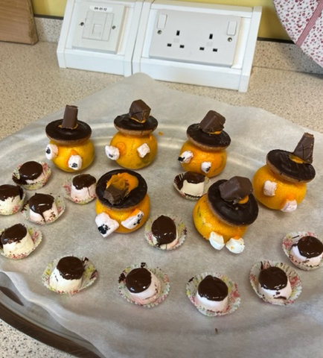
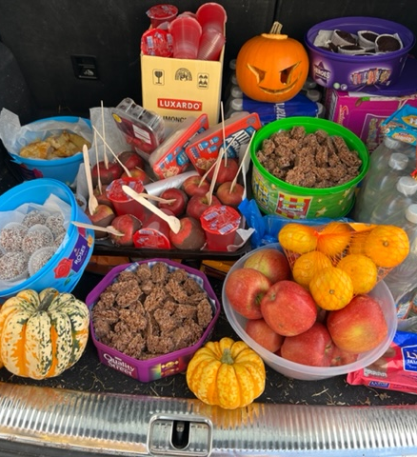
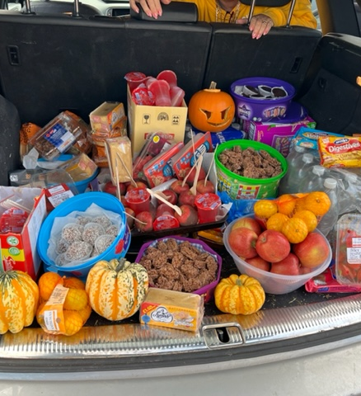
Halloween Spooktacular refreshments

Slide 16
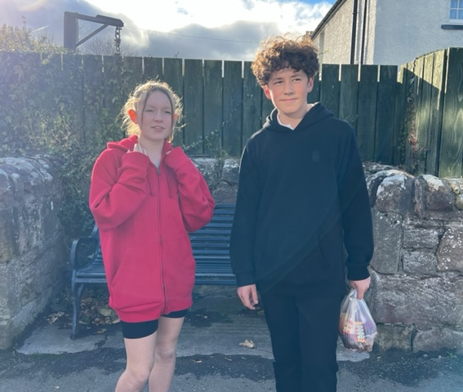
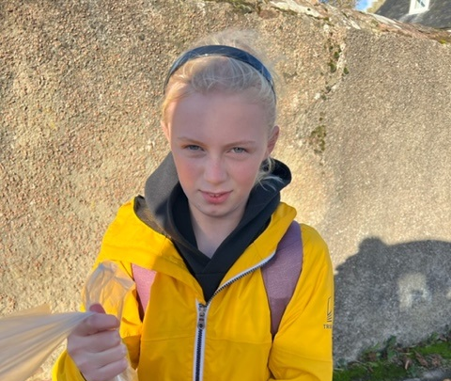
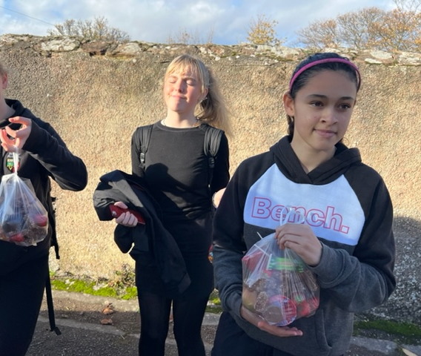
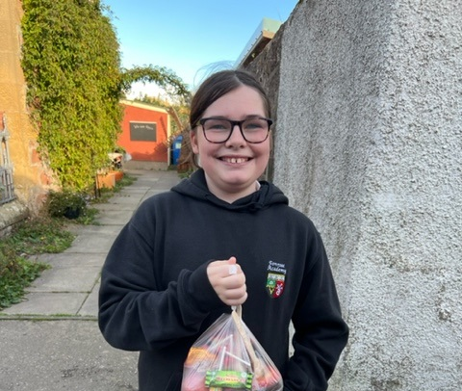
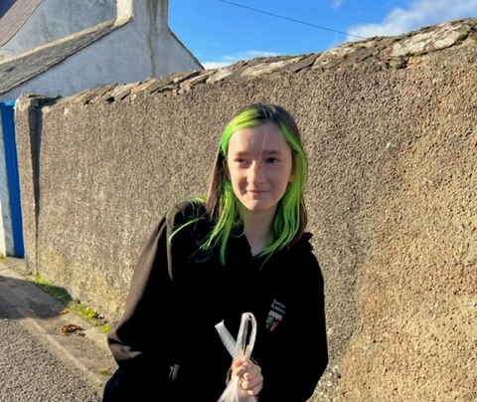
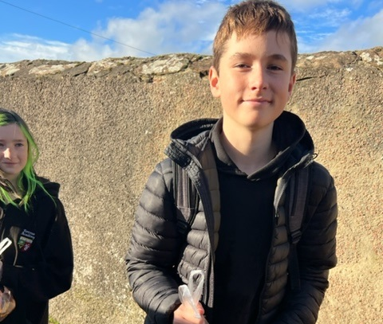

Slide 17
Multi-Sports
Delivered on a Monday by young leaders,
Young people have the opportunity to take part in a range of different sports and to try something new.
Young people have lots of fun each week.

Slide 18
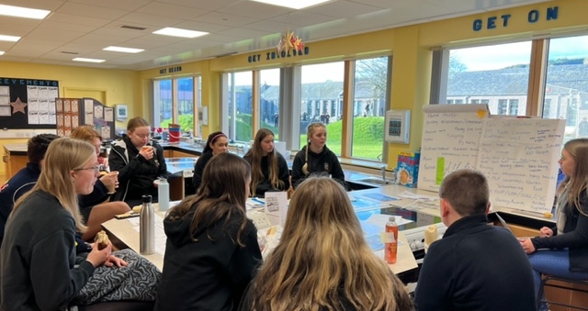
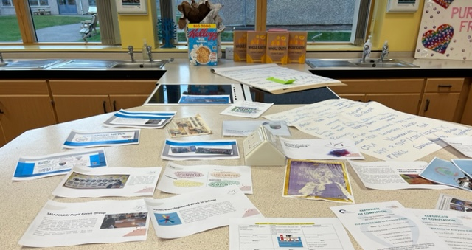
Youth Convener Roadshow
At the start of November the Highland’s Youth Convener was invited by Wanda to come and visit our young people who are on various different forums, for getting the voices of young people heard.
The young people spoke about the different projects and activities they are taking part in and or offering to other young people.

Slide 19
Cookwell / Bakewell
At every activity we provide for young people there is always a fresh wholesome meal or snack provided.
These meals are created by young people

Slide 20
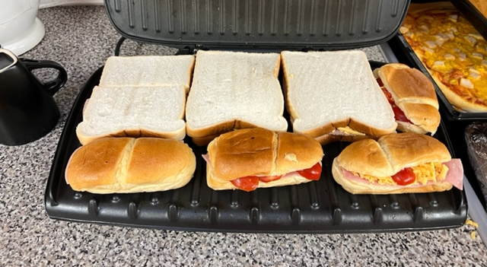
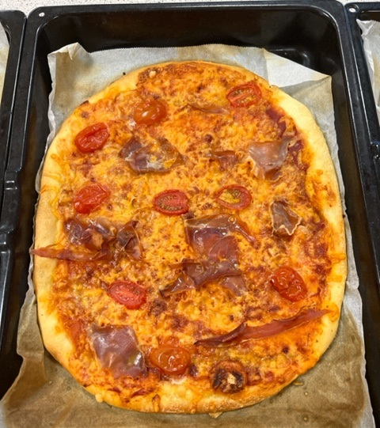
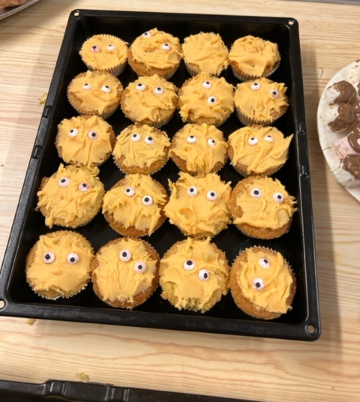
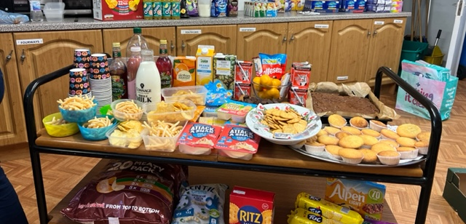
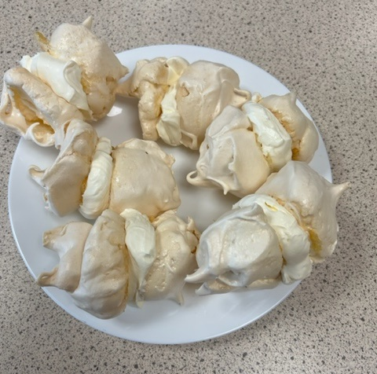
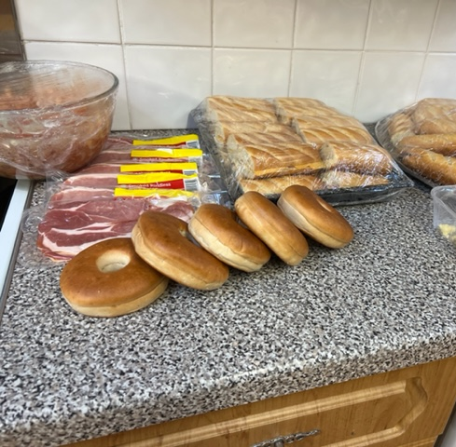

Slide 21
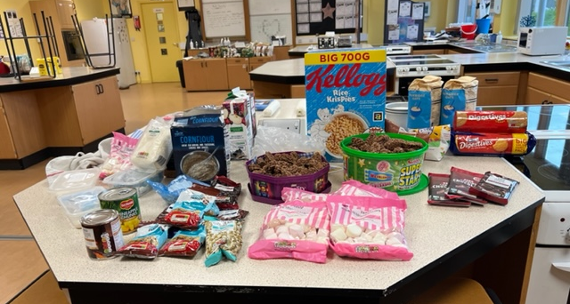
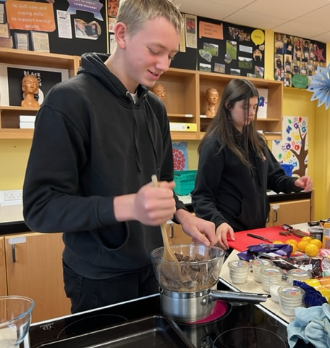
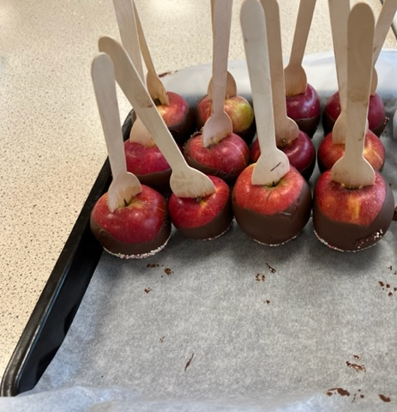
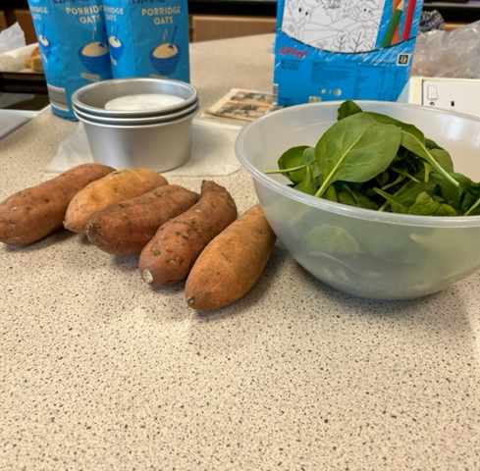

Slide 22
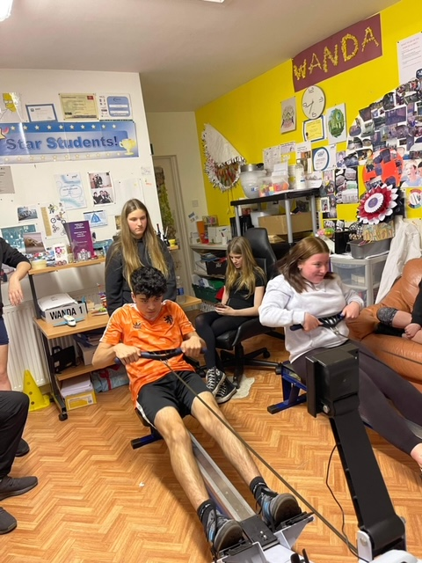
Indoor Rowing

Slide 23
Staff Development
Wanda & Myself have taken part in:
Recognition and Response to Child Protection – provided by Highlife Highland
Child Protection and Sport & Physical activity – provided by NSPCC
Wanda has been taking part in a range of different courses with Generations Working together (GWT), to help to promote Intergenerational sessions, not just nationally but world wide.
We have been invited along to the GWT conference with 3 young to present about our Intergenerational experiences in March 2023.

Slide 24
Thank you!
If you have any questions please contact myself ☺

